Slide 1
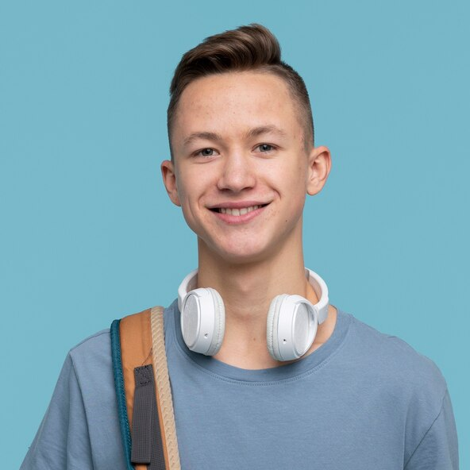
"Programming is the art of turning creativity into code."
Add image that represents this persona
Goals
I need to be a software engineer
I love playing sports
I love reading and writing
Frustrations
I hate chatter
Limited tech resources.
Balancing interests.
Seif Mohamed
Age:
Hometown:
Family:
16
Cairo, Egypt
his parents and his sister
Safe Mohamed, a 16-year-old from Cairo, Egypt, is a tech-savvy programmer. He aspires to become a software developer to create technology that enhances people's lives. He lives with his parents and adores his younger sister.

